Slide 1
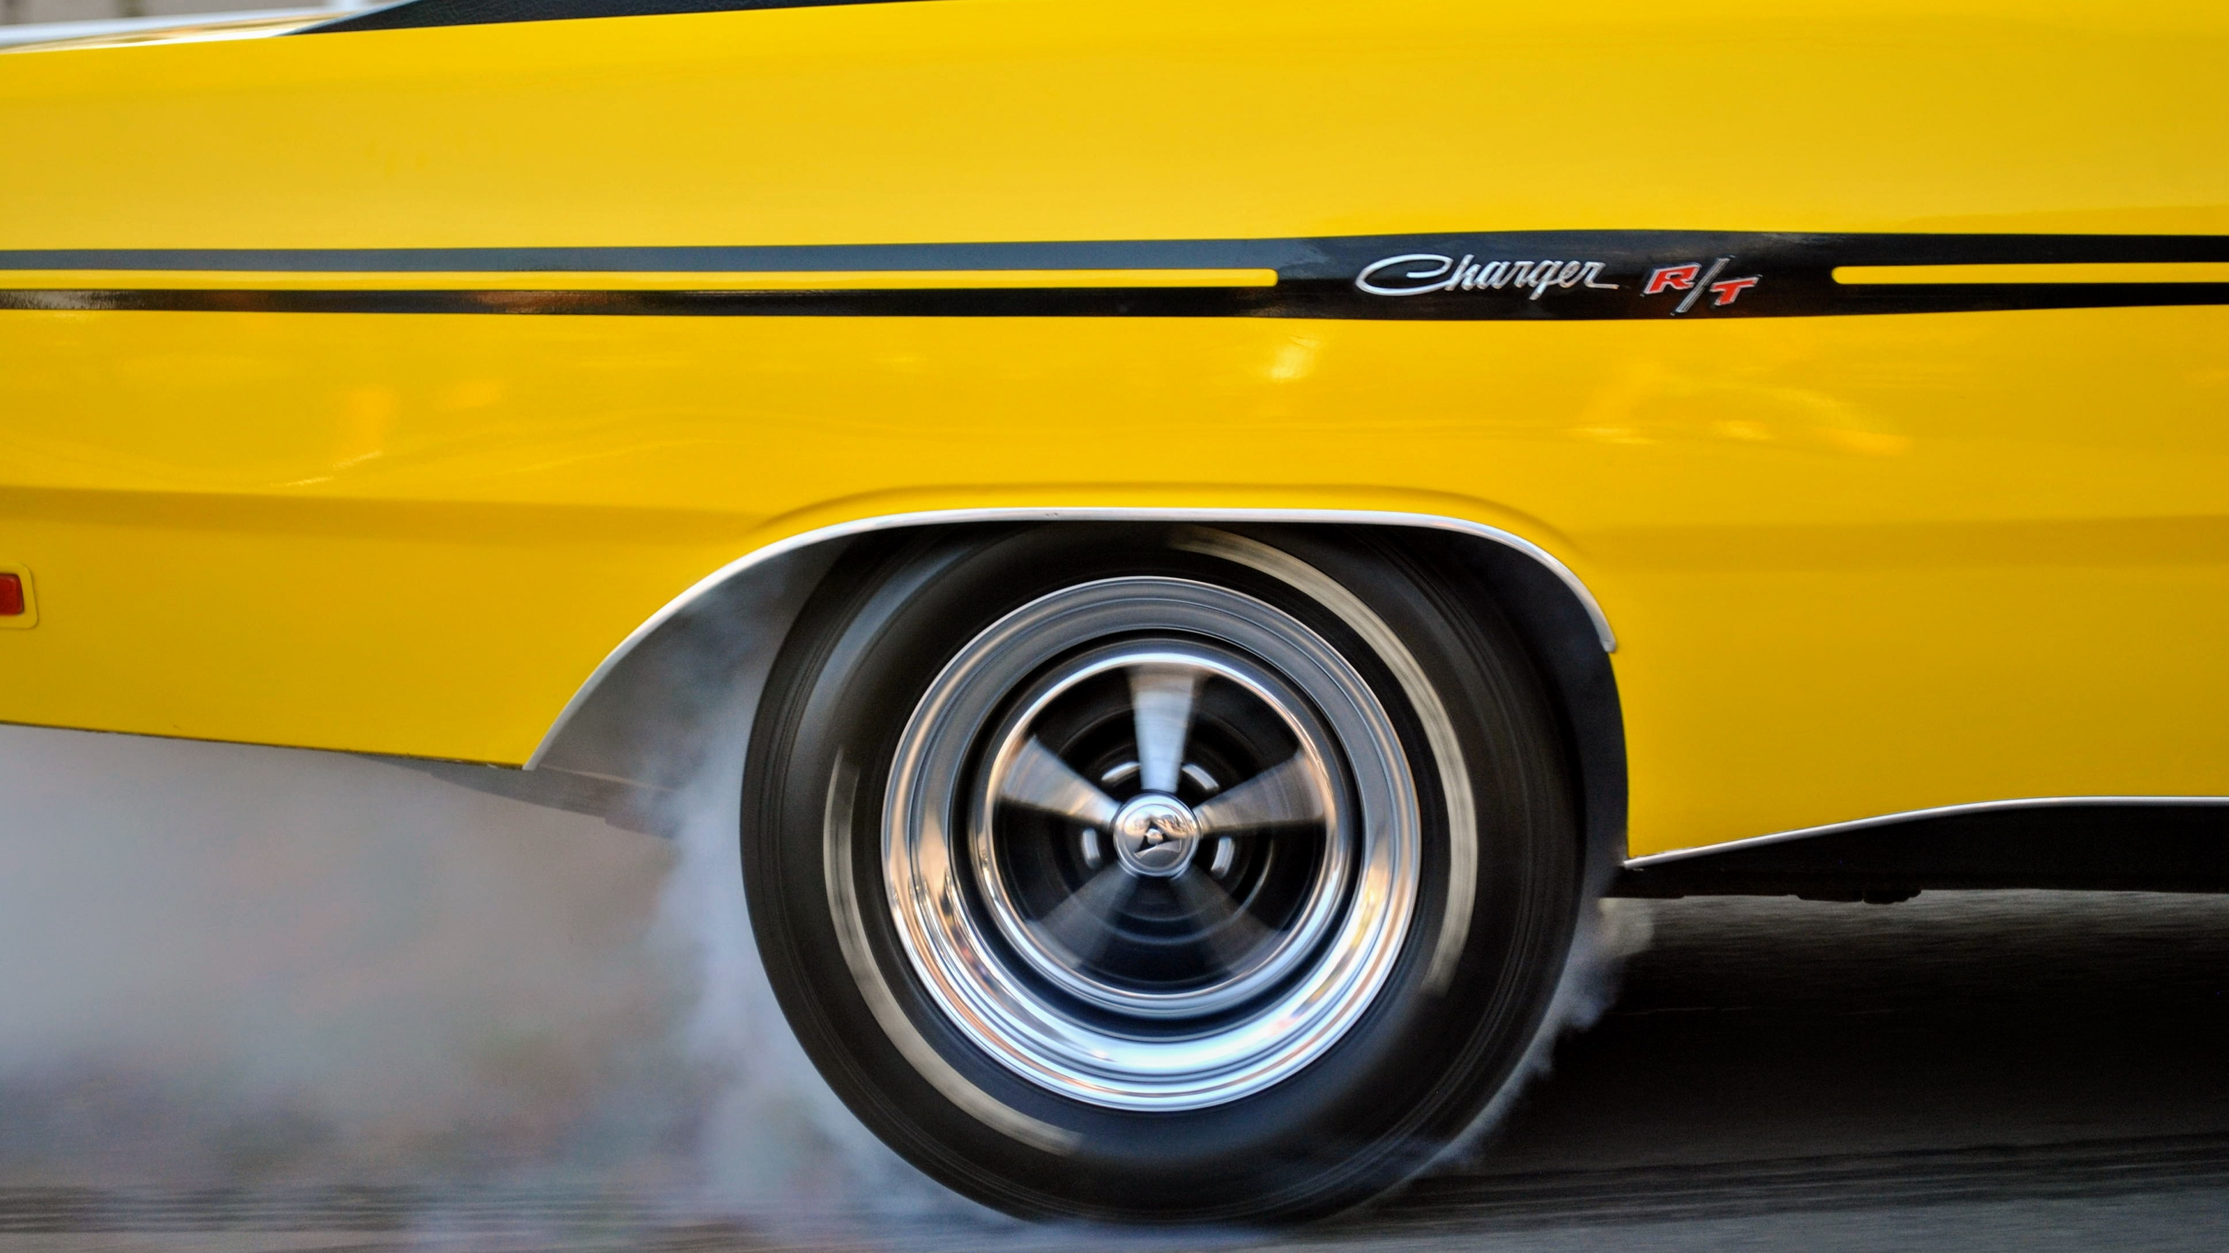
LARIAT Rent-A-Car
2018 Review
An analysis of Lariat’s 2018 performance to provide insight for future growth
By Frederic Randall
Photo by Uillian Vargas on Unsplash

Slide 2

2018 At A Glance
Net Revenue
Per Rental
$318
ROI
96%
Photo by Robert Bye on Unsplash

Slide 3

Our Customers & Locations
Branch Location
Performance
Top 5 Makes
Among All Age Groups
Ford
Chevrolet
Dodge
Toyota
GMC
Photo by Roland Denes on Unsplash

Slide 4
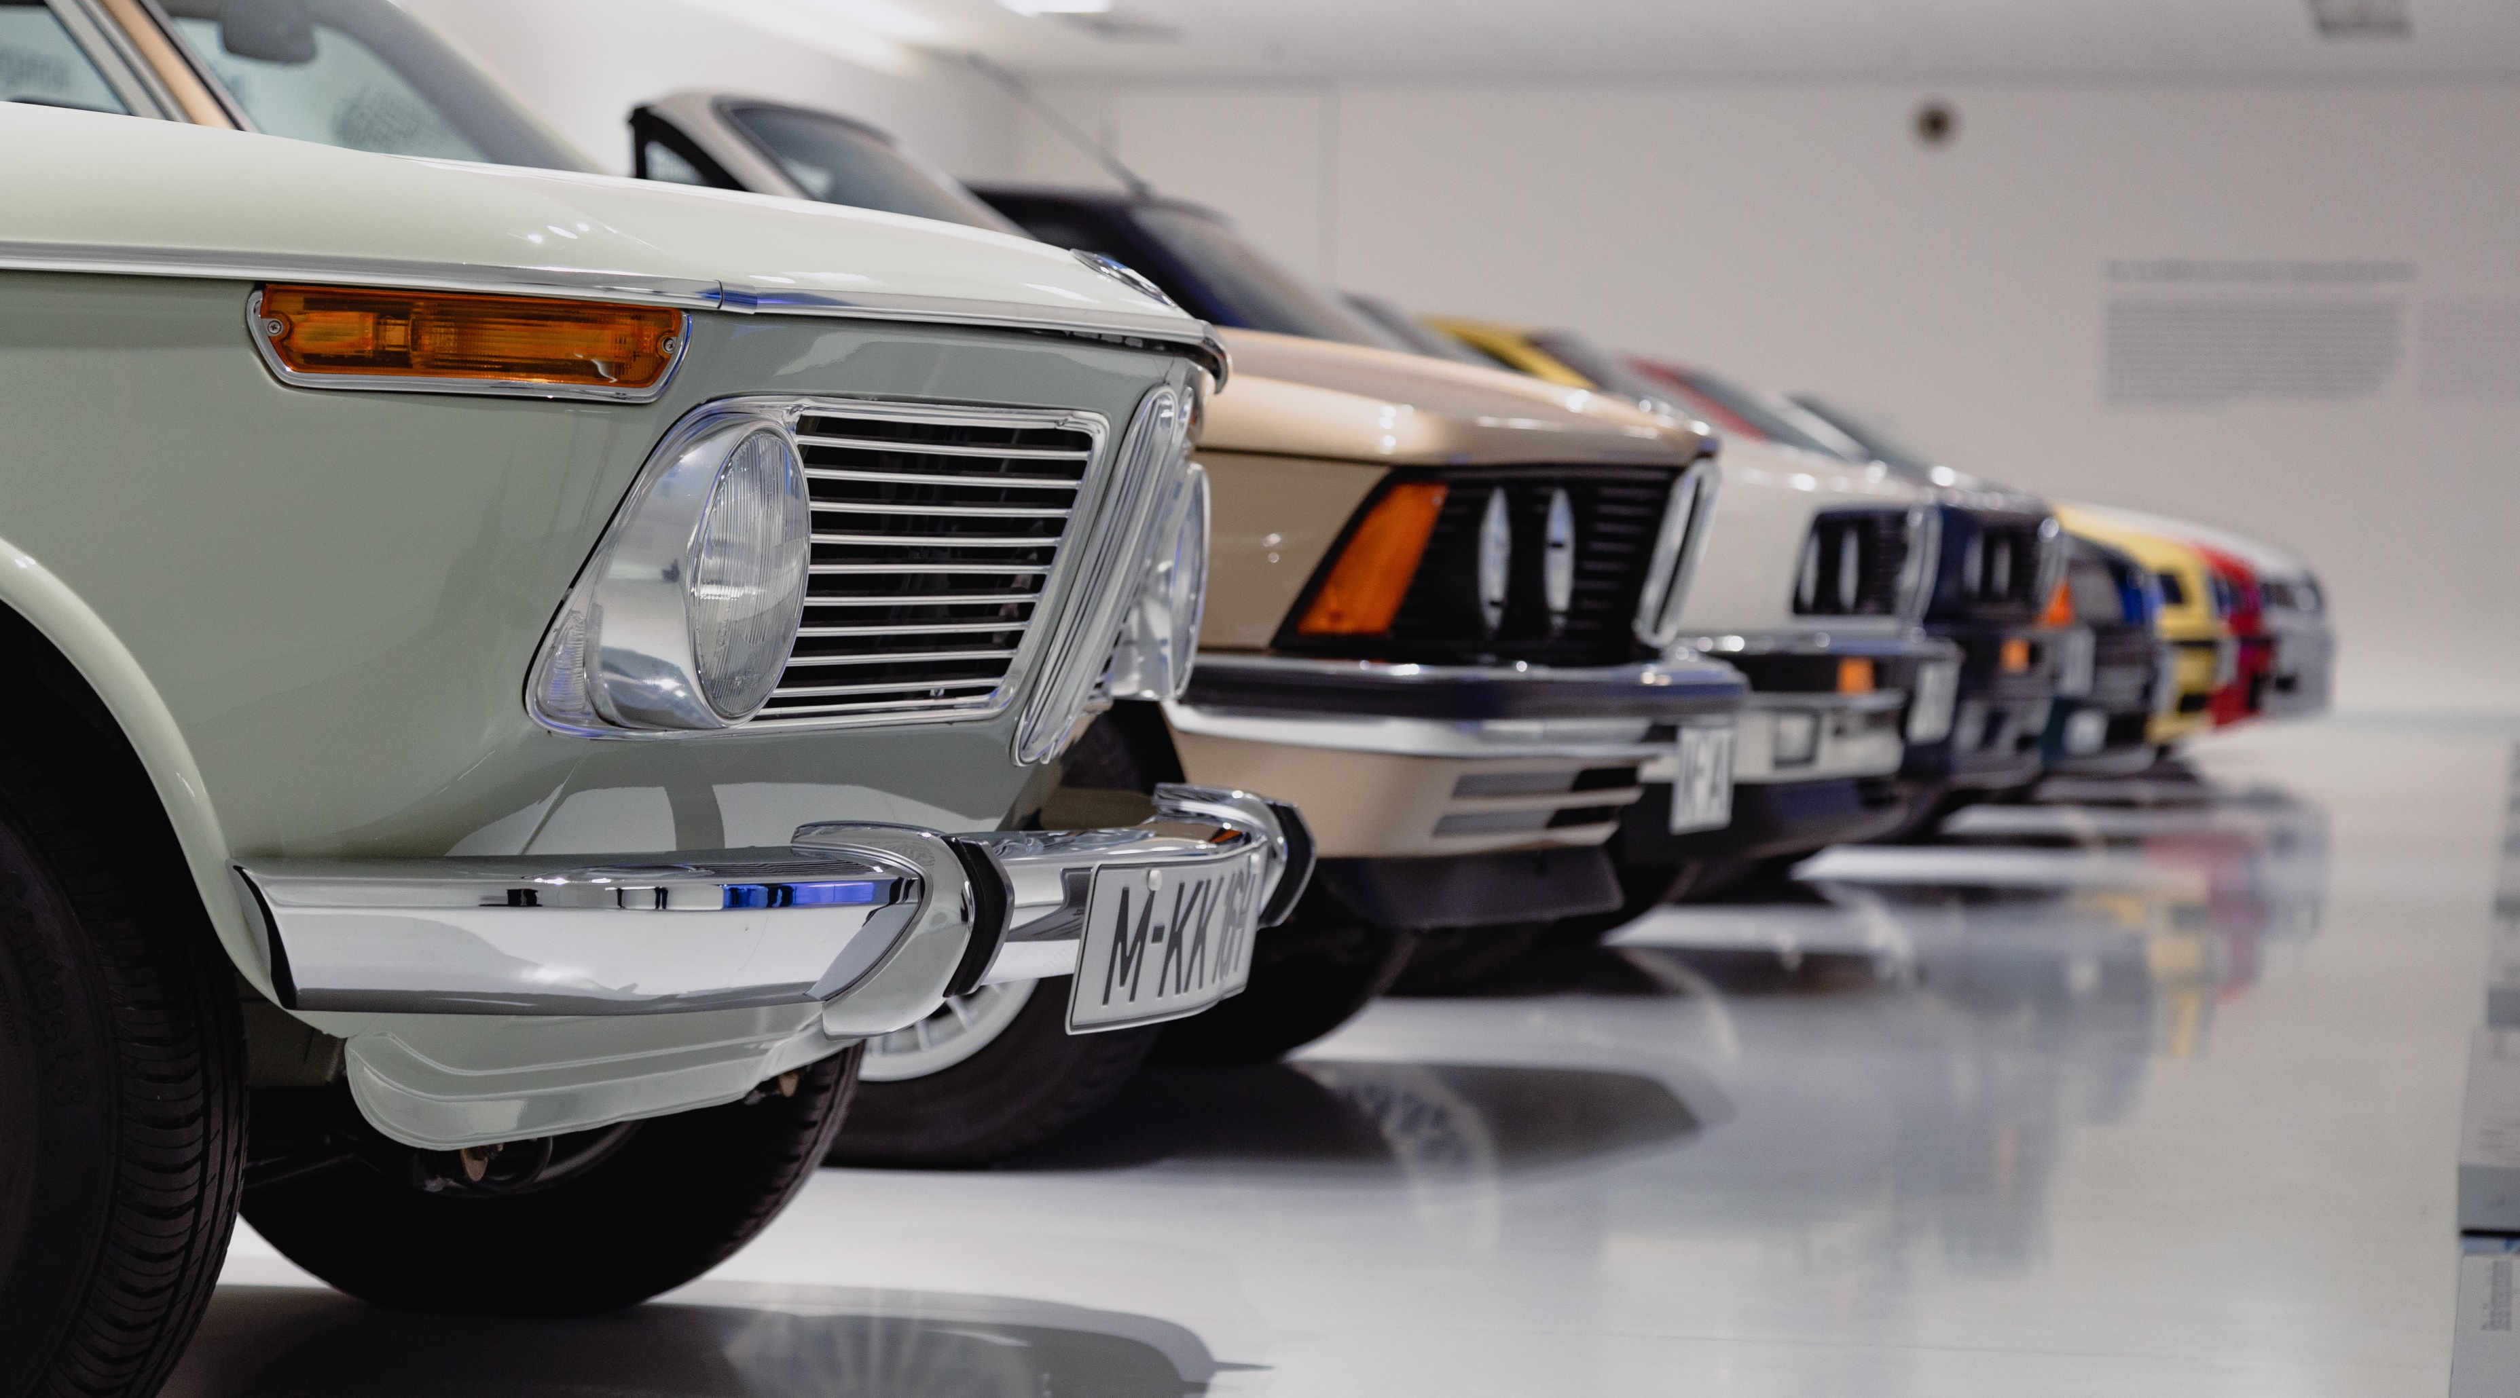
Our Vehicles
Photo by Alex Suprun on Unsplash

Slide 5

Strategy 1
Photo by Michael Jin on Unsplash

Slide 6

Strategy 2
Photo by Upal Patel on Unsplash

Slide 7

Strategy 3
Photo by Gordon Plant on Unsplash

Slide 8

Combined Strategies
Photo by Denys Nevozhai on Unsplash

Slide 9

Branches In Need
Photo by Ivana Cajina on Unsplash

Slide 10
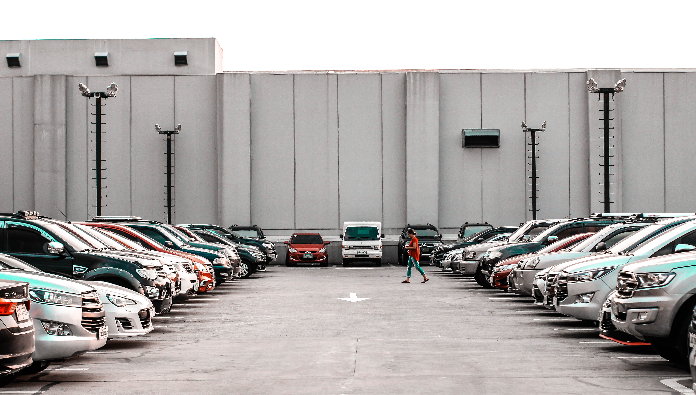
Conclusion
It would be beneficial to initially scale back on a variety of models. This will help to raise our performance level’s floor.
Once we establish a floor for yields standards, investment in models that have proven records of low costs and high demand.
While these strategies project considerable growth if implemented company wide, I recommend establishing these practices branch by branch.
Photo by Ruffa Jane Reyes on Unsplash

